Slide 1
PAVE-Peru Site Visit Study Debrief 03 November 2024

Slide 2
Program
PAVE-Peru study debrief:
Feasibility study (FS): Overview & Lessons learned [UPCH, Study PI]
Qualitative component [MMV, CT Social Scientist]
Costing component: CEA & BIA [MMV, CT Health Economist]

Slide 3
3. Costing Component
MMV-CT
Overview
Context: The study assesses a new treatment algorithm integrating TQ or PQ after G6PD deficiency screening for the treatment of P. vivax malaria in Peru.
Objective: Compare the current treatment standard (CQ+PQ7D without G6PD screening) vs. revised treatment algorithm (CQ+TQ/PQ7D or extended CQ+PQ8W with mandatory G6PD testing) to determine economic viability and health impact. In both algorithms the dosage is weight-based.
Studies Conducted:
Cost-Effectiveness Analysis (CEA): Evaluates the value of the revised algorithm over the current one.
Budget Impact Analysis (BIA): Estimates financial impact and savings under different rollout scenarios.

Slide 4
3. Costing Component
MMV-CT
Methods
Decision-Tree Modeling: tailored to Peru’s context using context-specific parameters, simulates 10,000 cases of P. vivax malaria, stratified by weight, gender, and G6PD status.
Population Subgroups:
Stratified by weight categories: 10-20 kg, 20-35 kg, >35 kg; and by gender: male and female.
Includes gender-specific scenarios, recognizing intermediate G6PD activity in females, and pregnancy.
Results were aggregated considering the cases distribution across demographic groups, to obtain single cost-effectiveness measures.
Costs and outcomes were calculated from the healthcare sector perspective.
Costs adjusted to reflect the Peruvian healthcare context, using MoH guidelines and epidemiological data.
BIA implementation scenario: 5-year rollout targeting 70% TQ coverage by year 5.

Slide 5
3. Costing Component
MMV-CT
Methods
Model assumptions:
G6PD Deficiency Rates: derived from regional studies (i.e., Brazil, Colombia).
Cost Estimates: conservative assumptions to ensure robust results; adjusted for inflation and logistics costs (e.g., transportation of TQ).
Treatment Adherence: TQ’s single-dose regimen expected to improve compliance over PQ's multi-day regimen.
Unaccounted Costs:
Some implementation expenses (e.g., policy updates, increased monitoring) excluded.
Future provider and public acceptance could impact uptake and efficiency.

Slide 6
3. Costing Component
MMV-CT
Key Findings: CEA
Improved Health Outcomes:
391 fewer recurrences and 0.3 deaths avoided per 10,000 cases
22 Disability-Adjusted Life Years (DALYs) adverted per 10,000 cases
Cost Savings:
$97,593 saved for every 10,000 cases
Incremental Cost-Effectiveness Ratio (ICER) below the threshold of $3,700 per DALY averted [Cost Effective: ICER = -4,52 $/DALY]
With per person cost buffer (+$17.8) to absorb unforeseen/other remaining cost
Key Findings: BIA
Implementation Impact:
Projected savings of $303,600 over five years, with gradual rollout of TQ reaching 70% coverage by Year 5.

Slide 7
3. Costing Component
MMV-CT
Challenges & Considerations
G6PD Screening Requirement: Mandatory for safe use of TQ and to prevent acute hemolytic anemia (AHA).
Pediatric Tafenoquine (pTQ): Pending approval in Peru; expected rollout to cover patients aged 2 years and above.
Provider and Public Acceptance: Implementation requires investment in training and awareness to ensure uptake.
Implementation Costs: Not fully accounted for beyond training expenses, which could affect the projected savings.

Slide 8
3. Costing Component
MMV-CT
Next Steps
Refinement of Scenarios: Ongoing consultation with Ministry of Health (MoH) to finalize rollout plans, to guide BIA model and results.
Validation and Stakeholder Engagement:
Final HEA Report and meetings scheduled with decision-makers in 2025.
Plans for publication of findings in scientific journals in 2025
Recommendation: Adoption of the revised algorithm is encouraged for cost-effective malaria management and alignment with WHO guidelines (i.e., G6PD testing) and (hopefully) upcoming recommendations of TQ.

Slide 9
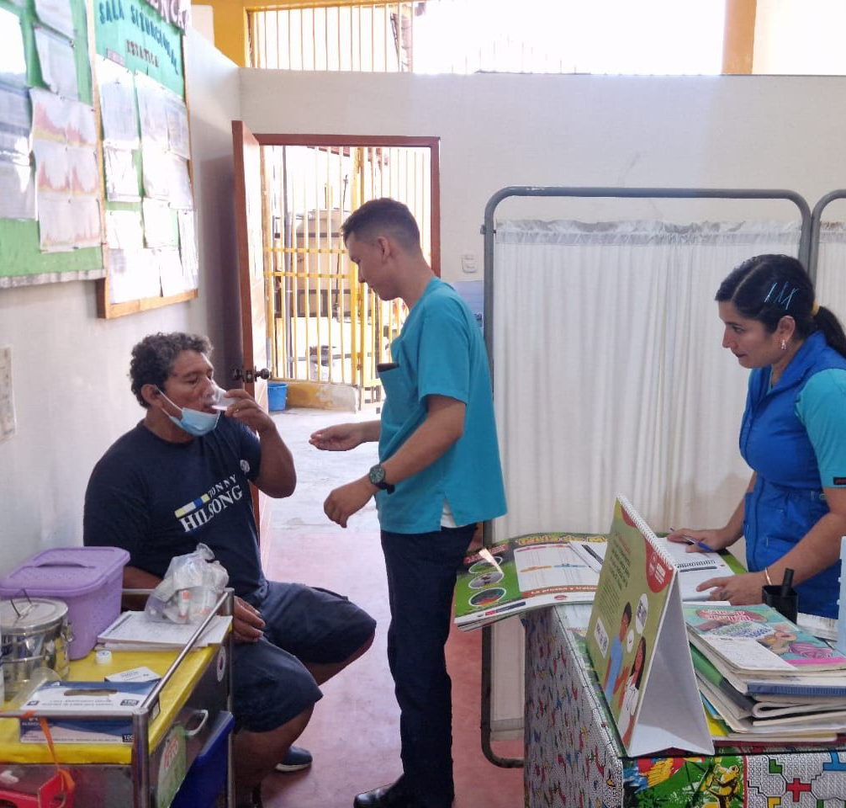

Questions?

Slide 10









Thank you

Slide 11
